Slide 1
C#

Slide 2

Arrays
Arrays are used to store multiple values in a single variable, instead of declaring separate variables for each value.
To declare an array, define the variable type with square brackets.
We have now declared a variable that holds an array of strings.
To insert values to it, we can use an array literal - place the values in a comma-separated list, inside curly braces:

Slide 3

Access the Elements of an Array
You access an array element by referring to the index number.
This statement accesses the value of the first element in cars:

Slide 4
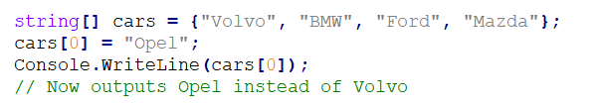
Change an Array Element
To change the value of a specific element, refer to the index number:

Slide 5

Array Length
To find out how many elements an array has, use the Length property:

Slide 6
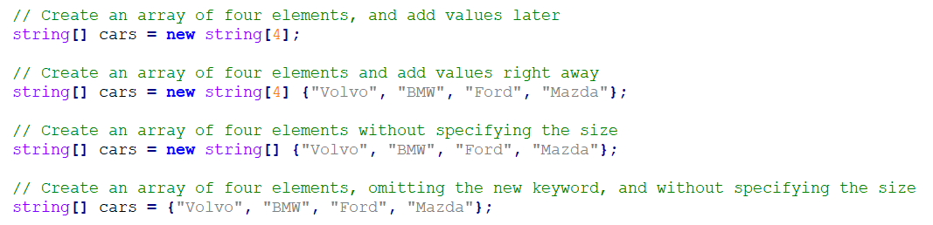
Other Ways to Create an Array
If you are familiar with C#, you might have seen arrays created with the new keyword, and perhaps you have seen arrays with a specified size as well.
In C#, there are different ways to create an array:

Slide 7
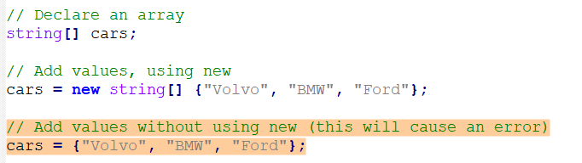
Other Ways to Create an Array
It is up to you which option you choose. In our tutorial, we will often use the last option, as it is faster and easier to read.
However, you should note that if you declare an array and initialize it later, you have to use the new keyword:

Slide 8
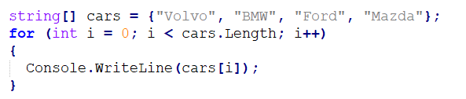
Loop Through an Array
You can loop through the array elements with the for loop, and use the Length property to specify how many times the loop should run.
The following example outputs all elements in the cars array:

Slide 9
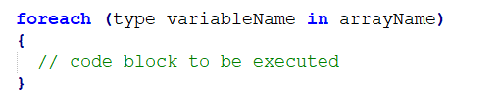
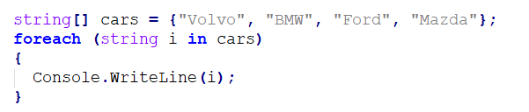
The foreach Loop
There is also a foreach loop, which is used exclusively to loop through elements in an array:
The following example outputs all elements in the cars array, using a foreach loop:

Slide 10
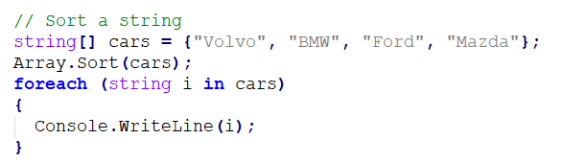
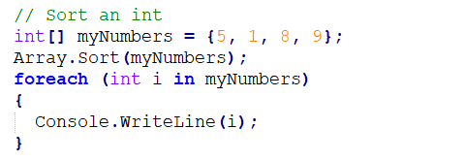
Sort an Array
There are many array methods available, for example Sort(), which sorts an array alphabetically or in an ascending order:

Slide 11
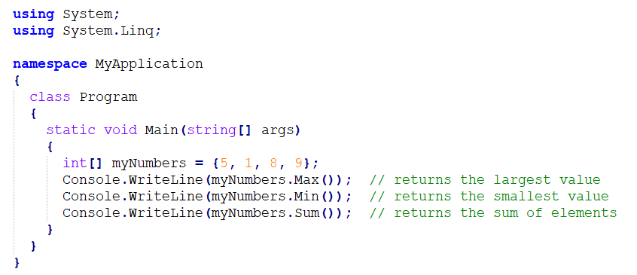
System.Linq Namespace
Other useful array methods, such as Min, Max, and Sum, can be found in the System.Linq namespace:

Slide 12
Multidimensional Arrays
Previously, you learned about arrays, which is also known as single dimension arrays. These are great, and something you will use a lot while programming in C#.
However, if you want to store data as a tabular form, like a table with rows and columns, you need to get familiar with multidimensional arrays.
A multidimensional array is basically an array of arrays.
Arrays can have any number of dimensions. The most common are two-dimensional arrays (2D).

Slide 13

Two-Dimensional Arrays
To create a 2D array, add each array within its own set of curly braces, and insert a comma (,) inside the square brackets:
* The single comma [,] specifies that the array is two-dimensional. A three-dimensional array would have two commas: int[,,].

Slide 14

Access Elements of a 2D Array
To access an element of a two-dimensional array, you must specify two indexes:
one for the array, and one for the element inside that array.
Or better yet, with the table visualization in mind;
one for the row and one for the column (see example below).
This statement accesses the value of the element in the first row (0) and third column (2) of the numbers array:

Slide 15

Change Elements of a 2D Array
You can also change the value of an element.
The following example will change the value of the element in the first row (0) and first column (0):

Slide 16
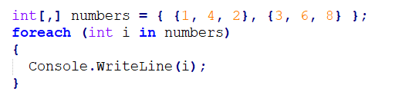
Loop Through a 2D Array
You can easily loop through the elements of a two-dimensional array with a foreach loop:

Slide 17
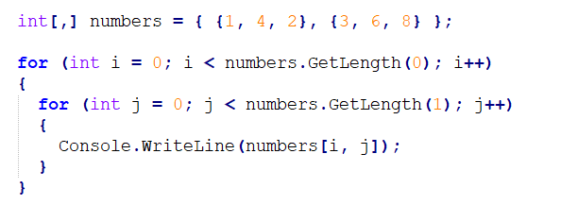
Loop Through a 2D Array
You can also use a for loop. For multidimensional arrays, you need one loop for each of the array's dimensions.
Also note that we have to use GetLength() instead of Length to specify how many times the loop should run:

